Slide 1

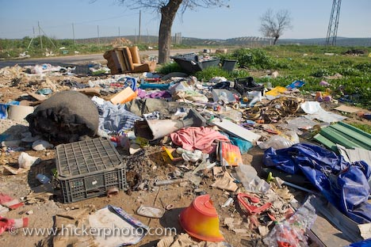
LAND POLLUTION

Slide 2
Land Pollution
per person per day generation of solid waste in urban area is 600-700 gm(approx.)
Areas of Concern are:
Disposal of huge volume of solid waste
Degradation and contamination of land by solid and liquid waste

Slide 3
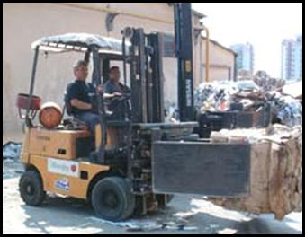
Solid Waste

Slide 4
Solid Waste
Materials non liquid or gas generated by anthropogenic activity and are discarded as useless or unwanted material

Slide 5
Cause
Over population
Affluence
Technology
Unplanned Industrialization
Unplanned Urbanization

Slide 6
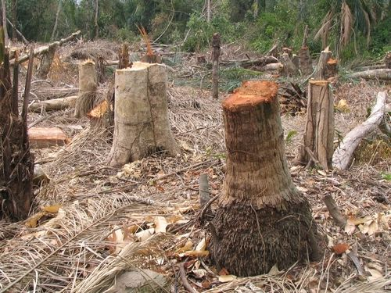
Deforestation

Slide 7
Types of Solid Waste
Non Hazardous Waste
Municipal Solid Waste
It includes:
# Domestic Waste
# Waste from Commercial place
# Constructional waste
It is of two types
Garbage and Rubbish

Slide 8
Types of Solid Waste
Industrial Waste
Agricultural waste

Slide 9
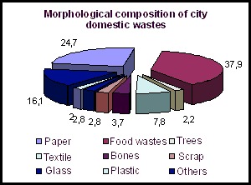

Slide 10
Hazardous Wastes
A waste or combination of wastes, which poses substantial threat to human health and environment

Slide 11
Features of Hazardous Waste
Reactivity
Ignitability
Corrosivity
Toxicity

Slide 12
Hazardous Wastes
Radioactive Waste
Chemical waste
  # From Industry
  # From Agriculture
Biomedical waste

Slide 13
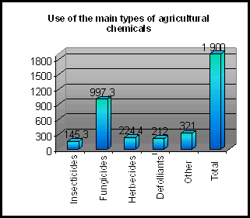
Agricultural wastes

Slide 14
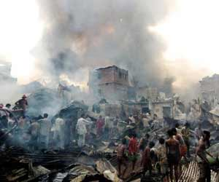
Plastic burning

Slide 15
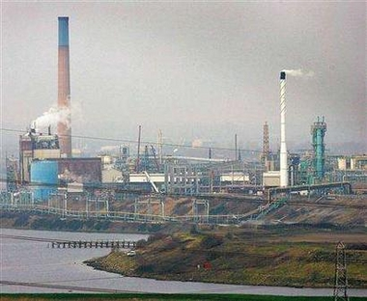
Industrialization

Slide 16
The Damage
Salinization
Acidification
Toxicity of the soil
Loss of soil texture
Erosion

Slide 17
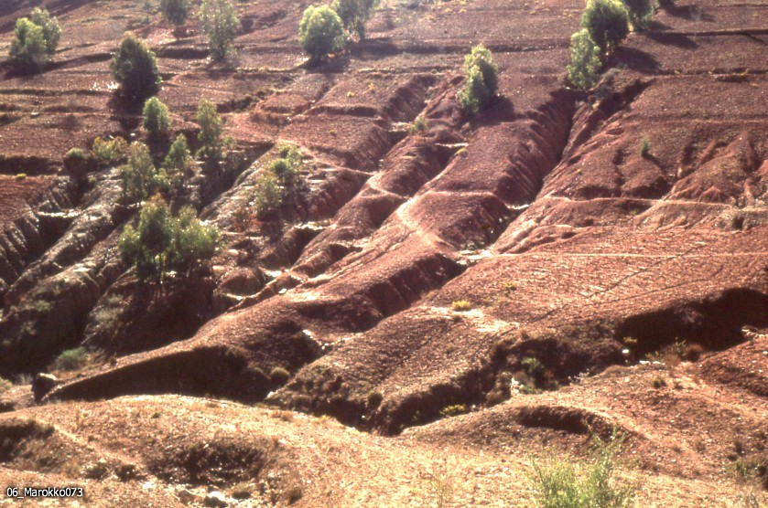
Soil Erosion

Slide 18
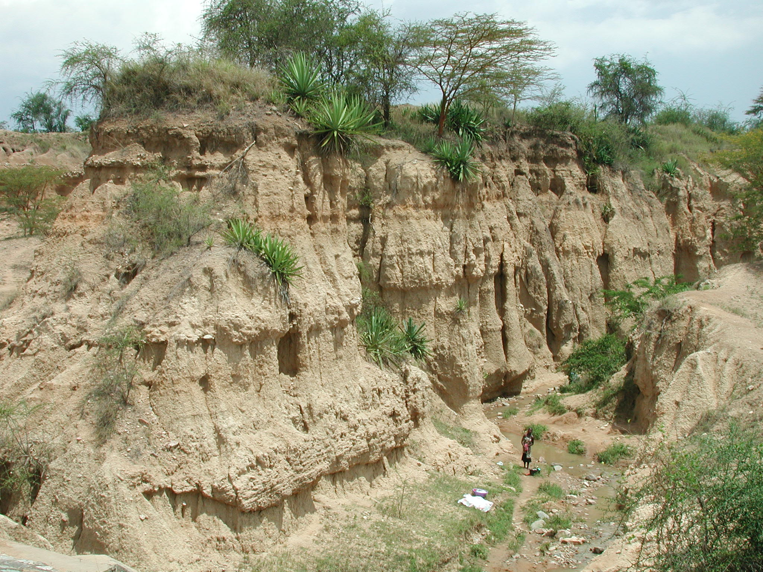
Soil Erosion

Slide 19
Managing erosion
Plantation activity
Terrace farming
Putting planks on the beaches and river banks

Slide 20
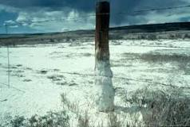
Salinization of soil

Slide 21
Salinization
Human practices can increase the salinity of soils by the addition of salts in irrigation water. Proper irrigation management can prevent salt accumulation by providing adequate drainage water to leach added salts from the soil

Slide 22
Management
Waste Management is of two types:
Non Hazardous Waste Management
Hazardous Waste Management

Slide 23
Management of Non Hazardous Waste
Collection
Storage
Transportation
Recycling
Disposal

Slide 24
4R Principle of Management
Management of non-hazardous solid waste
Refuse
Reuse
Recycle
Reduce

Slide 25
Disposal of Non hazardous Waste
Major disposal practiced in India:
Landfill
Incineration
Composting

Slide 26
Landfill
Landfill is the disposal of waste which cannot be reused, recycled or recovered, into or onto land

Slide 27

Landfill site

Slide 28
Landfill
It is a biological process
Aerobic decomposition
With the help of aerobic bacteria
Anaerobic decomposition
With the help of Methanogenic bacteria

Slide 29
Advantages of Landfill
Flies, fleas, mosquitoes can not grow
No bad odour
No air pollution
No bad look

Slide 30
Problems
In older landfills the possibility of ground water pollution
Possibility of explosion

Slide 31
Care should be taken
The material to be compressed leaving air spaces
There should be an exhaust vent
It should accompany a monitoring well

Slide 32
Incineration
Waste incineration is basically burning of waste
Efficiency of the system is more than 99%
For every 10,000 molecule entering in the incinerator 1 un-burnt molecule is released in the atmosphere

Slide 33
Efficiency depends on
Temperature of the combustion chamber
Time of combustion
Amount of turbulence
Availability of oxygen

Slide 34
Hazardous Waste Management
Identification
Handling
    Segregation
    Packaging
    Labeling
    Storage
    Transportation
Treatment
Disposal

Slide 35
Treatment
Physical:
  # Sedimentation
  # Aeration
Chemical
  # Neutralization
  # Oxidation reduction
  # Chemical precipitation
Biological

Slide 36
Disposal
Special care should be taken in disposing off hazardous waste material:
Sanitary landfil
Underground injection well
Surface impoundment

Slide 37
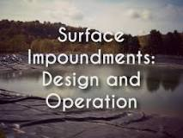

Slide 38
A lagoon or pond designed to hold waste materials and prevent their escap
Surface impoundments are a lot like landfill cells in that, “both units are either a natural topographic depression, manmade excavation formed primarily of earthen materials, such as soil.”

Slide 39
Additionally, both may be lined with manmade materials. Their uses, however, are what make them so different.
According to the EPA, “surface impoundments are generally used for temporary storage or treatment, whereas a landfill is an area designated for final waste disposal.”

Slide 40
The management
The cheapest way of disposal is co-disposal
Priority must be given in volume reduction
Choosing the right disposal method
Priority must be given in toxicity reduction

Slide 41
The best approach
Reduction in the generation of waste material be it hazardous or non hazardous

